Slide 1
Microsoft Azure
Let’s Grow 13-10-2021

Slide 2

Cloud Basics

Slide 3
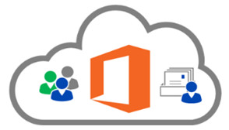
Cloud computing
Compute power - such as Linux servers or web applications.
Storage - such as files and databases.
Networking - such as secure connections between the cloud provider and your company.
Analytics - such as visualizing telemetry and performance data.
Cloud providers include Microsoft, Amazon, and Google
Notes:
Cloud computing - https://azure.microsoft.com/en-us/overview/what-is-cloud-computing/

Slide 4
Key concepts
High availability
Fault tolerance
Scalability
Elasticity
Global reach
Customer latency capabilities
Agility
Predictive cost considerations
Disaster recovery
Security
Notes:
There is a term reference guide available at https://azure.microsoft.com/en-us/overview/cloud-computing-dictionary/

Slide 5
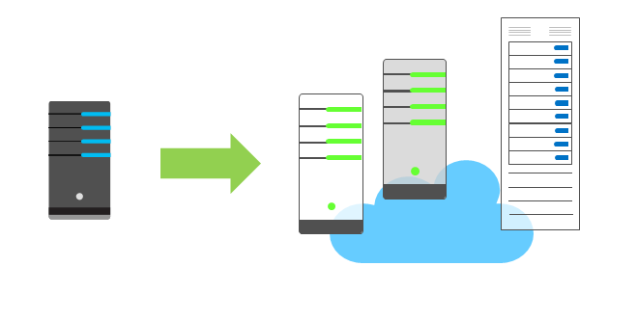
Economies of scale
The concept of economies of scale is the ability to reduce costs and gain efficiency when operating at a larger scale in comparison to operating at a smaller scale.
Cloud providers are very large businesses, and thus can leverage the benefits of economies of scale and then pass those benefits on to their customers.

Slide 6
CapEx vs. OpEx
Capital Expenditure (CapEx)
Spend on physical infrastructure upfront.
Deduct the expense from your tax bill.
High upfront cost, value of investment reduces over time.
Operational Expenditure (OpEx)
Spend on services or products as needed.
Get billed immediately.
Deduct the expense from your tax bill in the same year.
No upfront cost, pay-as-you use.

Slide 7
Consumption-based model
No upfront costs.
No need to purchase and manage costly infrastructure.
Ability to pay for additional resources as they are needed.
Ability to stop paying for resources that are no longer needed.

Slide 8
Shared responsibility model
On-Premises
( Private Cloud )
Infrastructure
( as a Service )
Platform
( as a Service )
Software
( as a Service )
Data & Access
Data & Access
Data & Access
Data & Access
Applications
Applications
Applications
Applications
You Manage
Runtime
Runtime
Runtime
Runtime
Cloud Provider Manages
Operating System
Operating System
Operating System
Operating System
Virtual Machine
Virtual Machine
Virtual Machine
Virtual Machine
Compute
Compute
Compute
Compute
Networking
Networking
Networking
Networking
Storage
Storage
Storage
Storage
Notes:
IaaS, PaaS, and SaaS have dedicated topics, coming up.

Slide 9
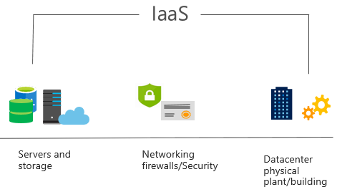
Infrastructure as a Service (IaaS)
Most basic cloud computing services category.
Build pay-as-you-go IT infrastructure by renting servers, virtual machines, storage, networks, and operating systems from a cloud provider.
Instant computing infrastructure, provisioned and managed over the internet.
Notes:
For more information on IaaS, visit https://azure.microsoft.com/en-us/overview/what-is-iaas/

Slide 10
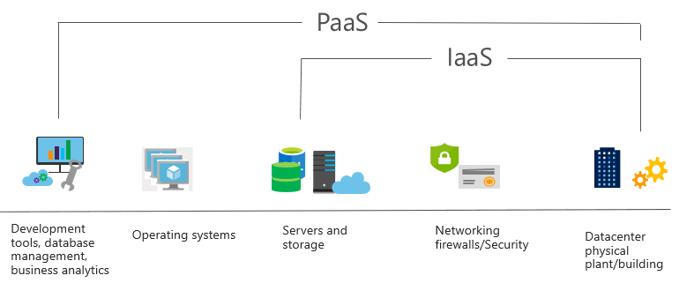
Platform as a Service (PaaS)
Provides environment for building, testing, and deploying software applications.
Helps create applications quickly, without focusing on managing underlying infrastructure.
Notes:
For more information on PaaS, see https://azure.microsoft.com/en-us/overview/what-is-paas/

Slide 11
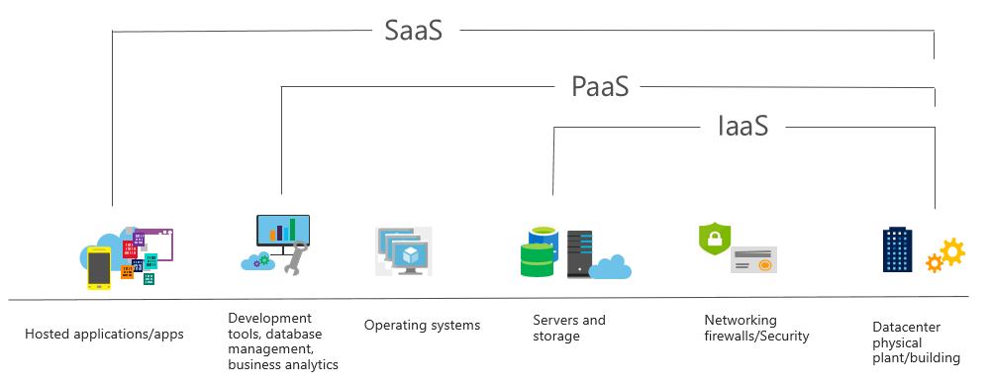
Software as a Service (SaaS)
Centrally hosted and managed software for end users. Users connect to and use cloud-based apps over the internet. For example, Microsoft Office 365, email, and calendars.
Notes:
Common usage scenarios:
Examples of Microsoft SaaS services include Microsoft Office 365, Skype, and Microsoft Dynamics CRM Online.
For more information on SaaS, see https://azure.microsoft.com/en-us/overview/what-is-saas/

Slide 12
Cloud service comparison
IaaS
PaaS
SaaS
The most flexible cloud service.
You configure and manage the hardware for your application.
Focus on application development.
Platform management is handled by the cloud provider.
Pay-as-you-go pricing model.
Users pay for the software they use on a subscription model.
Notes:
The slide contains only some of the cloud service comparison discussion points.

Slide 13
Regions
A region represents a collection of datacenters.
Provides flexibility and scale.
Preserves data residency.
Select regions close to your users.
Be aware of region deployment availability.
There are global services that are region independent.
Worldwide there are 54 regions representing 140 countries
Notes:
A list of regions and their locations is available at https://azure.microsoft.com/en-us/global-infrastructure/locations/

Slide 14
Region Pairs
Each Azure region is paired with another region.
Azure prefers at least 300 miles of separation between datacenters in a regional pair.
Some services provide automatic replication to the paired region.
In an outage, recovery of one region is prioritized out of every pair.
Azure system updates are rolled out to paired regions sequentially (not at the same time).
Paired regions are members of the same geography – except Brazil.
Region
North Central US​
East US​
West US 2​
US East 2​
Canada Central​
North Europe​
UK West​
Germany Central​
South East Asia​
East China​
Japan East​
Australia Southeast​
India South​
Brazil South (Primary)​
Region
South Central US​
West US​
West Central US​
Central US​
Canada East​
West Europe​
UK South​
Germany Northeast​
East Asia​
North China​
Japan West​
Australia East​
India Central​
South Central US ​
Notes:
A full list of region pairs is available at https://docs.microsoft.com/en-us/azure/best-practices-availability-paired-regions#what-are-paired-regions

Slide 15
Availability Options
VM SLA
VM SLA
VM SLA
MULTI-REGION DISASTER RECOVERY
99.9% with Premium Storage
99.95%
99.99%
Region 1
Region 2
SINGLE VM
AVAILABILITY SETS
AVAILABILITY ZONES
REGION PAIRS
Easier lift and shift
Protecting against failures within datacenters
Protection from entire datacenter failures
Regional protection within Data Residency Boundaries
Notes:
This slide is to introduce the upcoming topics. You could also use the slide at the end of the lesson to review.

Slide 16
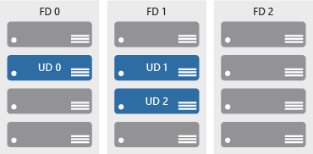

Availability zones
Azure Region
Physically separate locations within an Azure region.
Takes availability sets to the next level
Includes one or more datacenters, equipped with independent power, cooling, and networking.
Acts as an isolation boundary.
If one availability zone goes down, the other continues working.
Availability Zone 1
Availability Zone 2
Availability Zone 3
Notes:
More details about Availability Zones in Azure are available at https://docs.microsoft.com/en-us/azure/availability-zones/az-overview

Slide 17
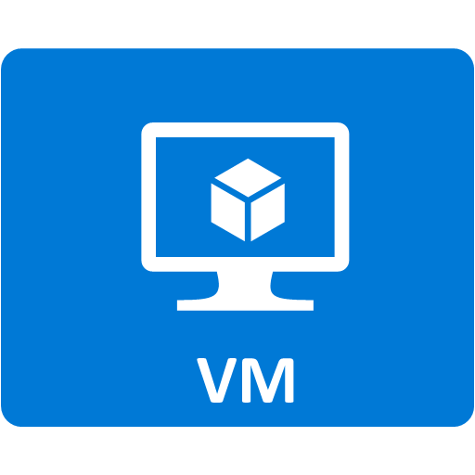


Resource groups
Resource groups (web + DB, VM, Storage) in one group
Containers for multiple resources that share the same life cycle.
Aggregates resources into a single manageable unit.
Every Azure resource must exist in one (and only one) resource group.
Secure at the resource group (or resource) level - using role-based access control (RBAC).
OR
Web and DB resource group
Virtual machine resource group
Storage resource group

Slide 18
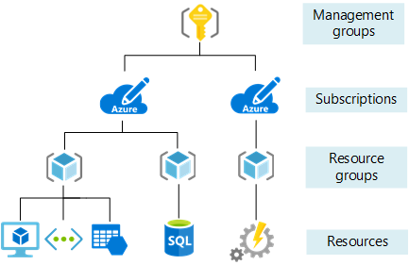
Azure Resource Manager
Provide a management layer that enables you to create, update, and delete resources in your Azure subscription.
Create, configure, manage and delete resources and resource groups.
Organize resources.
Control access and resources.
Automate using different tools and SDKs.
Notes:
You can view more details about Azure Resource Manager at https://docs.microsoft.com/en-us/azure/azure-resource-manager

Slide 19
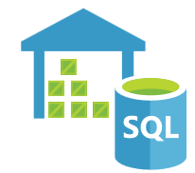

Big data and analytics
Azure SQL Data Warehouse is a cloud-based Enterprise Data Warehouse that leverages massively parallel processing to run complex queries quickly across petabytes of data.
Azure HDInsight is a fully-managed, open-source analytics service for enterprises. It is a cloud service that makes it easier, faster, and more cost-effective to process massive amounts of data.
Azure Data Lake Analytics is an on-demand analytics job service that simplifies big data. Instead of deploying and tuning hardware, you write queries to transform your data and extract valuable insights.
Notes:
Azure SQL Data Warehouse - https://azure.microsoft.com/en-us/services/sql-data-warehouse/
Azure HDInsight - https://azure.microsoft.com/en-us/services/hdinsight/
Azure Data Lake Analytics - https://azure.microsoft.com/en-us/services/data-lake-analytics/
Data and Analytics services - https://azure.microsoft.com/en-us/product-categories/analytics/

Slide 20


Artificial Intelligence
Azure Machine Learning service provides a cloud-based environment used to develop, train, test, deploy, manage, and track machine learning models.
Azure Machine Learning Studio is a collaborative, drag-and-drop visual workspace where you can build, test, and deploy machine learning solutions without needing to write code.
Notes:
Azure Machine Learning Service - https://azure.microsoft.com/en-us/services/machine-learning-service/
Azure Machine Learning Studio - https://azure.microsoft.com/en-us/services/machine-learning-studio/
Note: For a full list of Artificial Intelligence and Machine Learning services available with Azure, see the AI + Machine Learning section on the https://azure.microsoft.com/en-us/overview/ai-platform/ page.

Slide 21



Serverless computing
Azure Functions is code running your service and not the underlying platform or infrastructure. Creates infrastructure based on an event.
Azure Logic Apps is a cloud service that helps you automate and orchestrate tasks, business processes, and workflows when you need to integrate apps, data, systems, and services.
Azure Event Grid is a fully-managed, intelligent event routing service that uses a publish-subscribe model for uniform event consumption.
Notes:
Azure Functions - https://docs.microsoft.com/en-us/azure/azure-functions/
Azure Logic Apps - https://docs.microsoft.com/en-us/azure/logic-apps/
Azure Event Grid - https://docs.microsoft.com/en-us/azure/event-grid/
Note: For more details about serverless services available with Azure, see https://azure.microsoft.com/en-us/solutions/serverless/

Slide 22


DevOps
Azure DevOps services provides development collaboration tools including pipelines, Git repositories, Kanban boards, and extensive automated and cloud-based load testing.
Azure DevTest Labs allows you to quickly create environments in Azure while minimizing waste and controlling cost.
Notes:
Azure DevOps Services - https://docs.microsoft.com/en-us/azure/devops/
Azure DevTest Labs - https://azure.microsoft.com/en-us/services/devtest-lab/
Note: For more general details on DevOps services available with Azure, see https://docs.microsoft.com/en-us/azure/#pivot=products&panel=devops

Slide 23
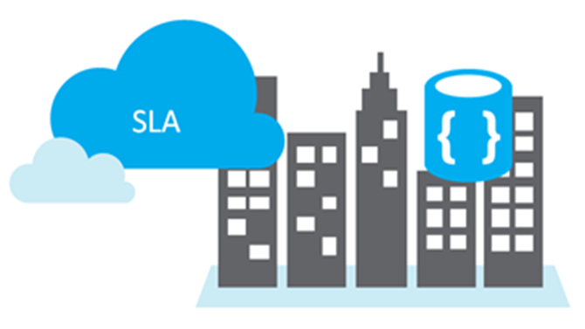
Service Level Agreements (SLAs)
SLAs document the specific terms that define Azure performance standards.
SLAs define Microsoft’s commitment to an Azure service or product.
Individual SLAs are available for each Azure product and service.
SLAs also define what happens if a service or product fails to meet the designated availability commitments.

Slide 24
SLAs for Azure products and services
Performance targets are expressed as uptime and connectivity guarantees.
Performance-targets range from 99.9% (three nines) to 99.99% (four nines).
If a service fails to meet the guarantees, a percentage of the monthly service fees can be credited to you.
SLA | Downtime per month | Downtime per year
99.9% | 43.2 minutes | 8.76 hours
99.95 | 21.6 minutes | 4.38 hours
99.99 | 4.32 minutes | 52.56 minutes
Notes:
You might want to browse to some SLA’s directly https://azure.microsoft.com/en-us/support/legal/sla/summary/ and explore one or two as examples.

Slide 25
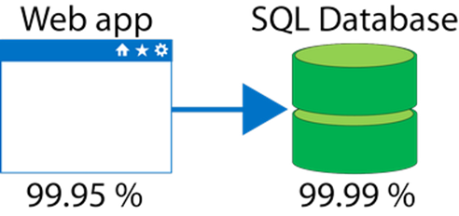
Composite SLAs
If the App Service has a 99.95% SLA, and the Azure SQL Database has a 99.99% SLA, what is the composite SLA for your application?
Notice the composite SLA is lower than the individual SLAs.
Improve the SLA by creating independent fallback paths.
Composite SLA
.9995 * .9999
= 99.94%

Slide 26
Application SLAs
Customers should determine what SLA is needed for their application.
Know your workload requirements and usage patterns.
Design for resiliency and availability.
Establish availability metrics — mean time to recovery (MTTR) and mean time between failures (MTBF).
Establish recovery metrics — recovery time objective and recovery point objective (RPO).
Implement resiliency strategies.
Build in availability requirements.
Notes:
For more information about improving application SLAs, refer to https://docs.microsoft.com/en-us/azure/architecture/resiliency/

Slide 27
Practice
https://docs.microsoft.com/en-us/azure/app-service/quickstart-dotnetcore?tabs=netcore31&pivots=development-environment-vs
https://docs.microsoft.com/en-us/aspnet/core/tutorials/publish-to-azure-webapp-using-vscode?view=aspnetcore-5.0
https://docs.microsoft.com/en-us/azure/azure-functions/functions-create-your-first-function-visual-studio?tabs=in-process&pivots=programming-runtime-functions-v3
https://docs.microsoft.com/en-us/azure/azure-functions/durable/durable-functions-create-first-csharp?pivots=code-editor-vscode

